Slide 1
DATA-54000 Large Scale Data Storage Week 7 – Assignment Notes
Prof. Manoj M. Bhat
Email : bhatma@lewisu.edu

Slide 2
Assignments
Convert CSV into various formats to check file sizes
Options:
Option 1: Use AWS Glue
Option 2: Use Bitnami Hadoop Spark

Slide 3
Hands-on assignment
We will be continue with the airline on-time performance data for this week
For this week, we will look at 3-6 months of data(~ 20 MB per month)
NOTE: The files are large and so don’t try to open it up in a text editor
Once the data is download and transformed, convert the CSV data into different storage formats ( ORC, Parquet etc..)
Compare the size of the output files (CSV, ORC, Parquet)
and report your findings

Slide 4
Assignment – steps
Download the Airline data for 1-2 quarters ( 3-6 output files)
Choose the following data items: YEAR, MONTH, DAY, ORIGIN, DEST, DEP_DEL15 and ARR_DEL15, CANCELLED
Remove the header line from all files except the first
First Month file : leave the header line
Second month onwards : remove the header line
To remove the 1st line, use the linux ‘sed’ command as:
sed ‘1d’ file.csv > newfile.csv
Use the ‘head’ command to verify : head newfile.csv
Run the Linux ‘cat’ command to combine many files into 1. For example,
cat ManojJan.csv ManojFeb.csv ManojMarch.csv > Manoj-Q1-2020.csv

Slide 5
Verification and upload
Run the Linux ‘head’ on combined file to ensure that the first line has the column names and that the file begins with the first month of the quarter
Run the Linux ‘tail’ on combined file to ensure that the file ends with the last month of the quarter
Upload the combined file to
Option 2: VM’s /tmp folder (for use with Spark)
Option 1: S3 for use with Glue

Slide 6
Assignment - steps
You should have just 1 file with data in CSV format
If using AWS Glue:
Upload the data into S3
Create an ETL job to write the data in different formats
NOTE: You will see a small charge ( less than $5) on the AWS bill for using Glue. So, monitor the AWS bills and delete services when you are done using them.
If using Bitnami Hadoop:
Use pySpark to save files in different formats
Check the file sizes after conversion

Slide 7
Using Spark in Bitnami

Slide 8
High-level steps
Verify the location of the combined Airline data file
Start pyspark
Create a dataframe by reading from the CSV file
Save the data into ORC and Parquet by using the ‘write’ functions
Exit pyspark
Run the ‘du -h’ command to get the file sizes of the text, ORC and Parquet files
Compare the file sizes of the text, ORC and parquet formats

Slide 9
Known issue with Bitnami
In Bitnami Hadoop, running ‘pyspark’ may give an error saying ‘python not found’.
Create a symbolic link (‘shortcut’) by running this command:
sudo ln /usr/bin/python3 /usr/bin/python

Slide 10
Spark commands
Read the CSV file from the folder where you placed the datafile
df = spark.read.format('csv').option('inferSchema','true').option('header','true').load('/datafile.csv')
Convert into parquet and ORC. The function call looks the same for both formats.
You need to replace the ??? with the appropriate function name
Provide the full path and an appropriate filename in ‘outputfile’
Provide compression type in quotes, for example ‘none’ or ‘gzip’ or ‘snappy’
df.write.????(‘output file’, mode=None, partitionBy=None, compression=None)
Note that the write commands will create sub-folders
You need to look inside the sub-folders to see the files created

Slide 11
Spark commands
To read parquet files use the same spark.read function but provide “parquet” as the format
df = spark.read.format("parquet").load(“…..”)
To print the schema, use the printSchema() function of the DataFrame
To display the contents, use show()
To display the count, use count()

Slide 12
S3 and Glue

Slide 13
Steps
Upload the combined Airlines data file into an S3 bucket
Login to AWS and then go to Glue
Create a Glue database
Create a Glue table using a crawler
Specify the CSV file in the S3 bucket
A table will be created with the information from the S3 file
Once the initial table is created, use AWS Glue Studio to create jobs to save CsvToOrc and CsvToParquet
Make sure that the IAM role has full permissions to S3
After output files are created, run the AWS S3 CLI command to get the file sizes
https://docs.aws.amazon.com/glue/latest/dg/getting-started.html

Slide 14
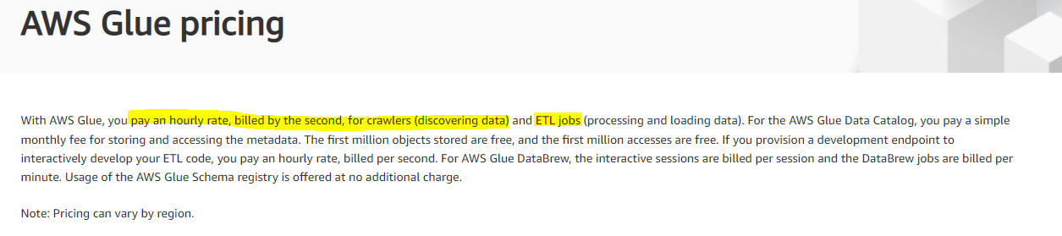
Charges
Glue crawlers and ETL jobs are not part of the Free Tier
You will end up with some charges on your AWS account
Based on prior experience, this should be less than $5.
Remember to delete all Glue resources when you are done

Slide 15
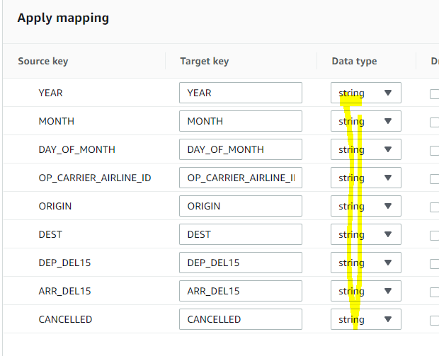
Issues with Glue Parquet
If you get LongType error, then change the data types in the transform box :
Change all types to String (Long to String and Double also to String)
Make sure you save the changes.

Slide 16
AWS Clean up
Stop the EC2 instance(s)
Delete the S3 buckets used for the airline data
Delete the Glue resources – tables, crawlers, database, jobs and S3 buckets
Deactivate the IAM keys

Slide 17
End of presentation

